Slide 1

Cost Estimation of Solar Plant & Net Metering
PRESENTED BY :217_Tushar Kaushik and !39_Rajnikant Tiwari(G-87)
COURSE AND BATCH: PG-DAC Sept 2021
PRN No : 210941220214 & 210941220137
PROJECT GUIDE: Mr. Milind Arjun

Slide 2
Your best quote that reflects your approach… “It’s one small step for man, one giant leap for mankind.”
- Neil Armstrong

Slide 3
Introduction
This system is designed as per the requirement of users to that they can have intuitive and personalized web-interface for facilitating access to information and services that are of primary relevance and interests to the users.
It is a system design especially for rooftop solar power plants which could be setup at domestic or small-scale industrial areas. This system will help user to get the estimated cost of the power plant and further net-metering will help to understand the payback period of the plant.

Slide 4
Motivation
As we know that energy demand is increasing which is leading to several environmental crisis and climate change, so we need to adapt a system which can meet the demands as well as a green source of energy.
This motivated us to use our knowledge to come up with an unique and simple solution to users to create awareness among people as well as to educate about solar energy.
As we know due to pandemic people are more worried about covid and avoiding direct contact with installers. So this portal will help them to understand the system as well as provide them estimated cost of solar plant as per requirement.

Slide 5
Objectives
The main purpose of this system is to provide an user the user-friendly interface system in which he/she does not require any educational level, experience or technical expertise in computer or energy field.
The second purpose is to create an awareness towards of solar energy and it’s need as well as to make user to understand the net metering.
The third purpose is to provide a hassle free system in which user can get estimated cost of solar plant on the basis of his/her requirement.
Other purpose is to provide necessary information such as Indian states’ solar policies as well as information on different solar equipments.

Slide 6
Technology Used
JAVAEE
Back End: Java Spring Boot
Front End: Thymeleaf
Database First Approach
ASP.NET

Slide 7
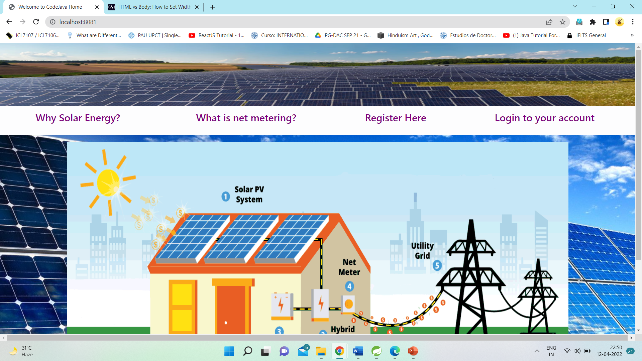
Screen Shots

Slide 8
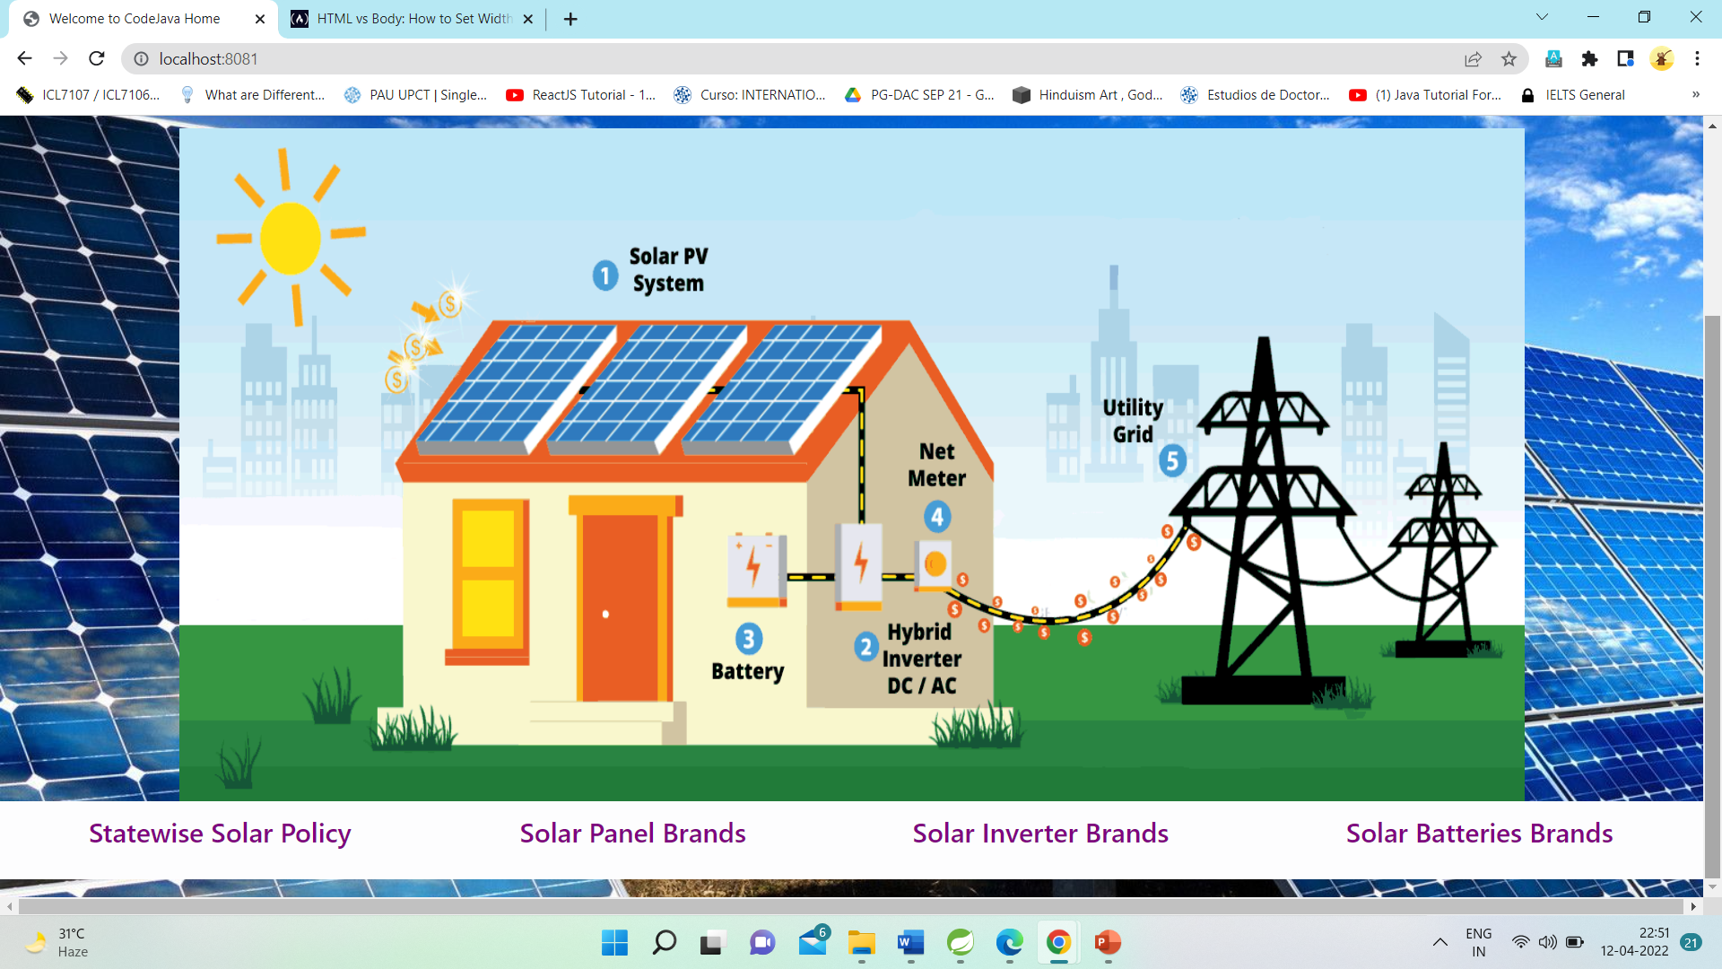

Slide 9
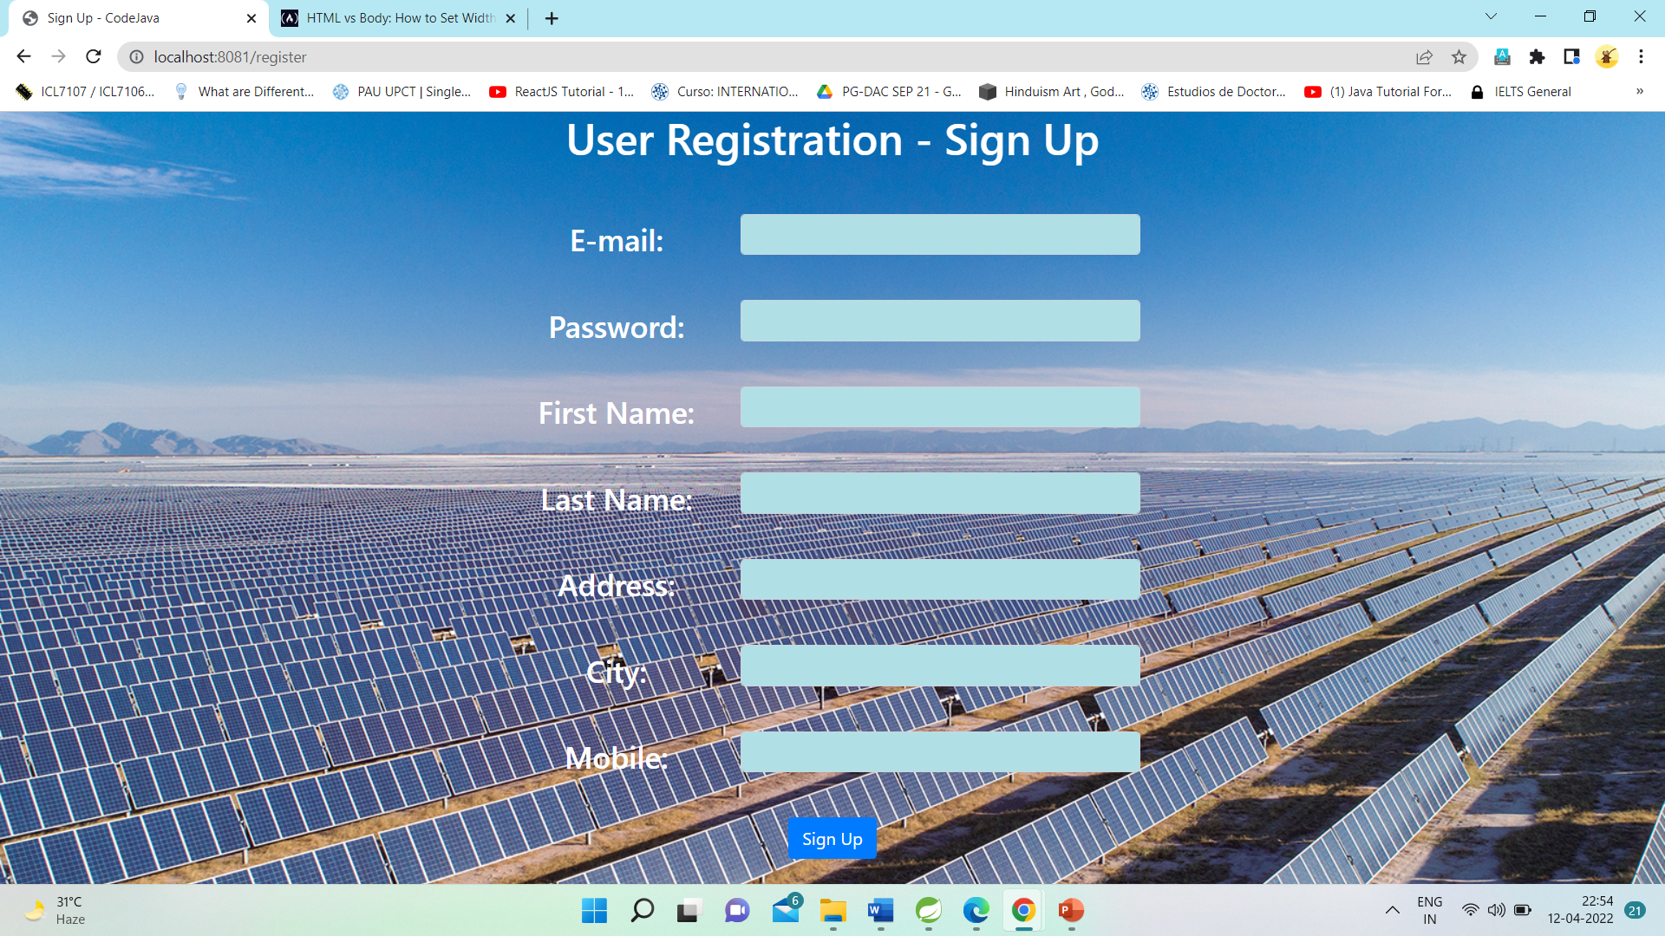
Registration Page

Slide 10
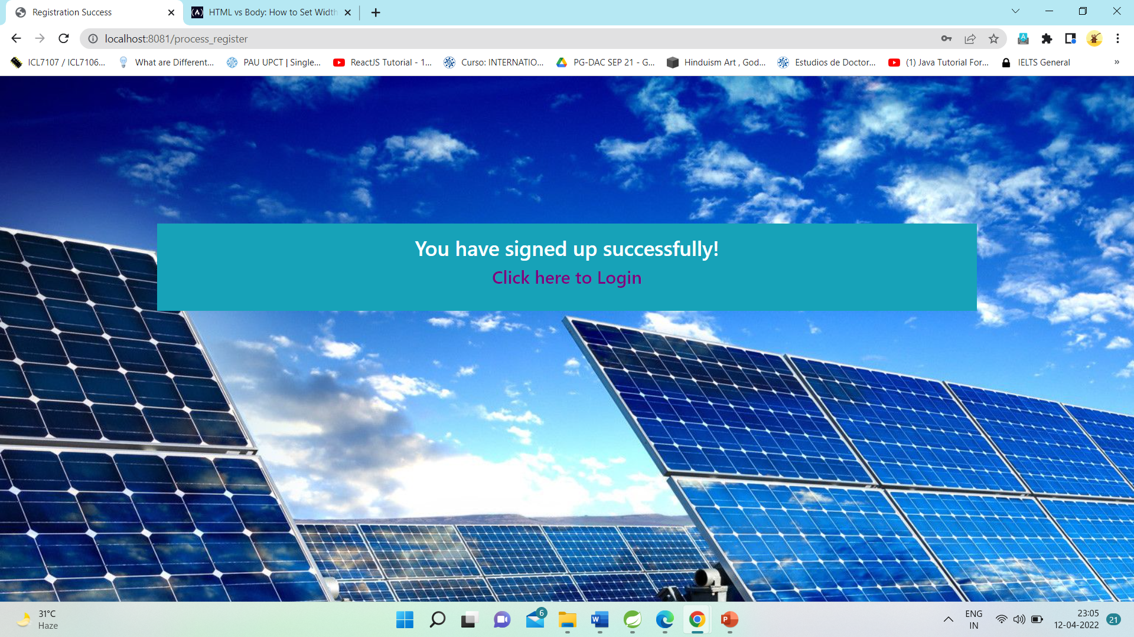
Page on Successful Registration

Slide 11
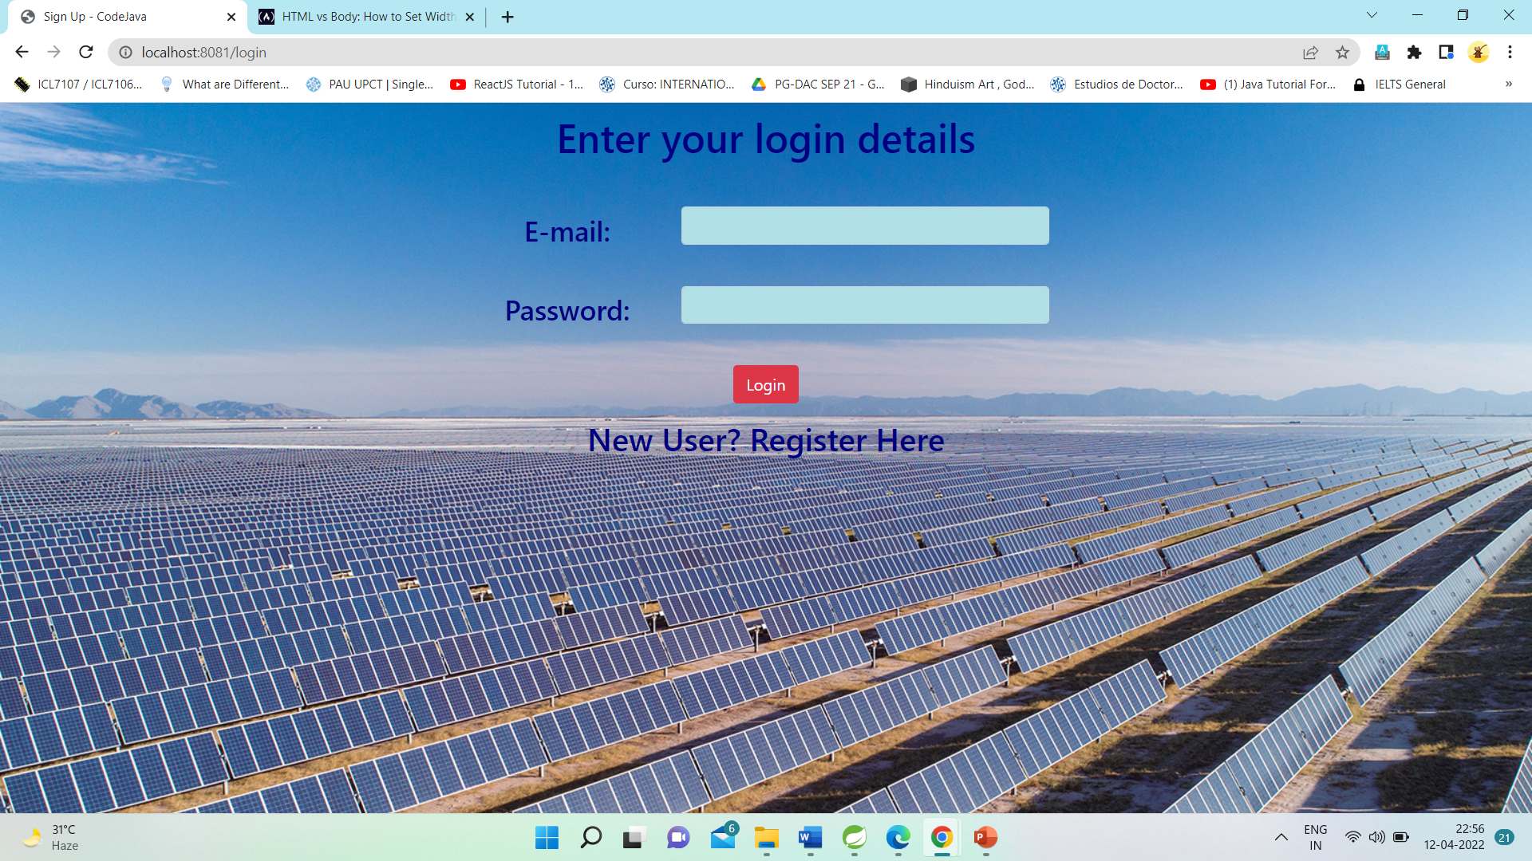
Login Page

Slide 12
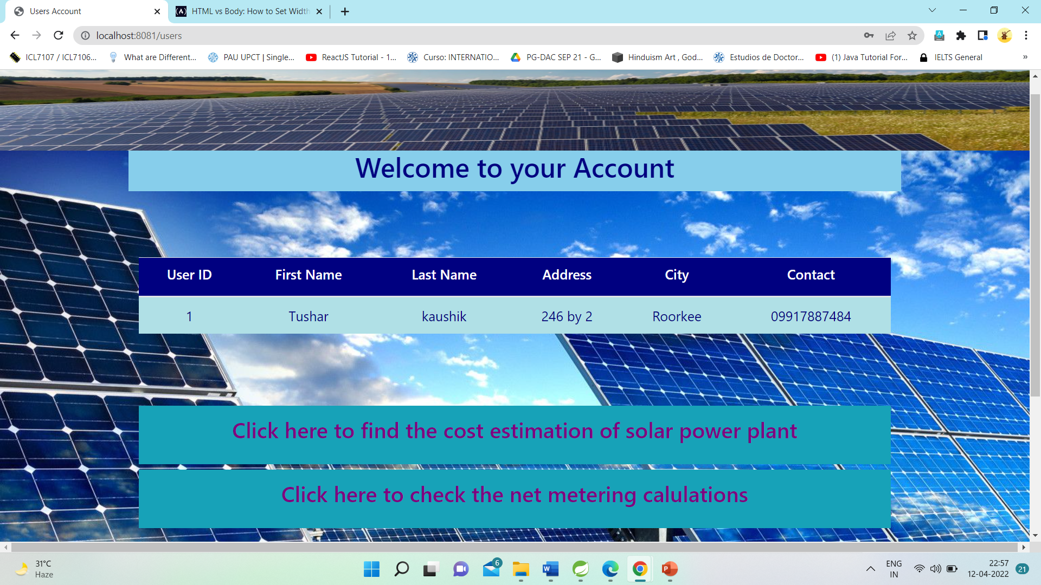
User Home-Page

Slide 13
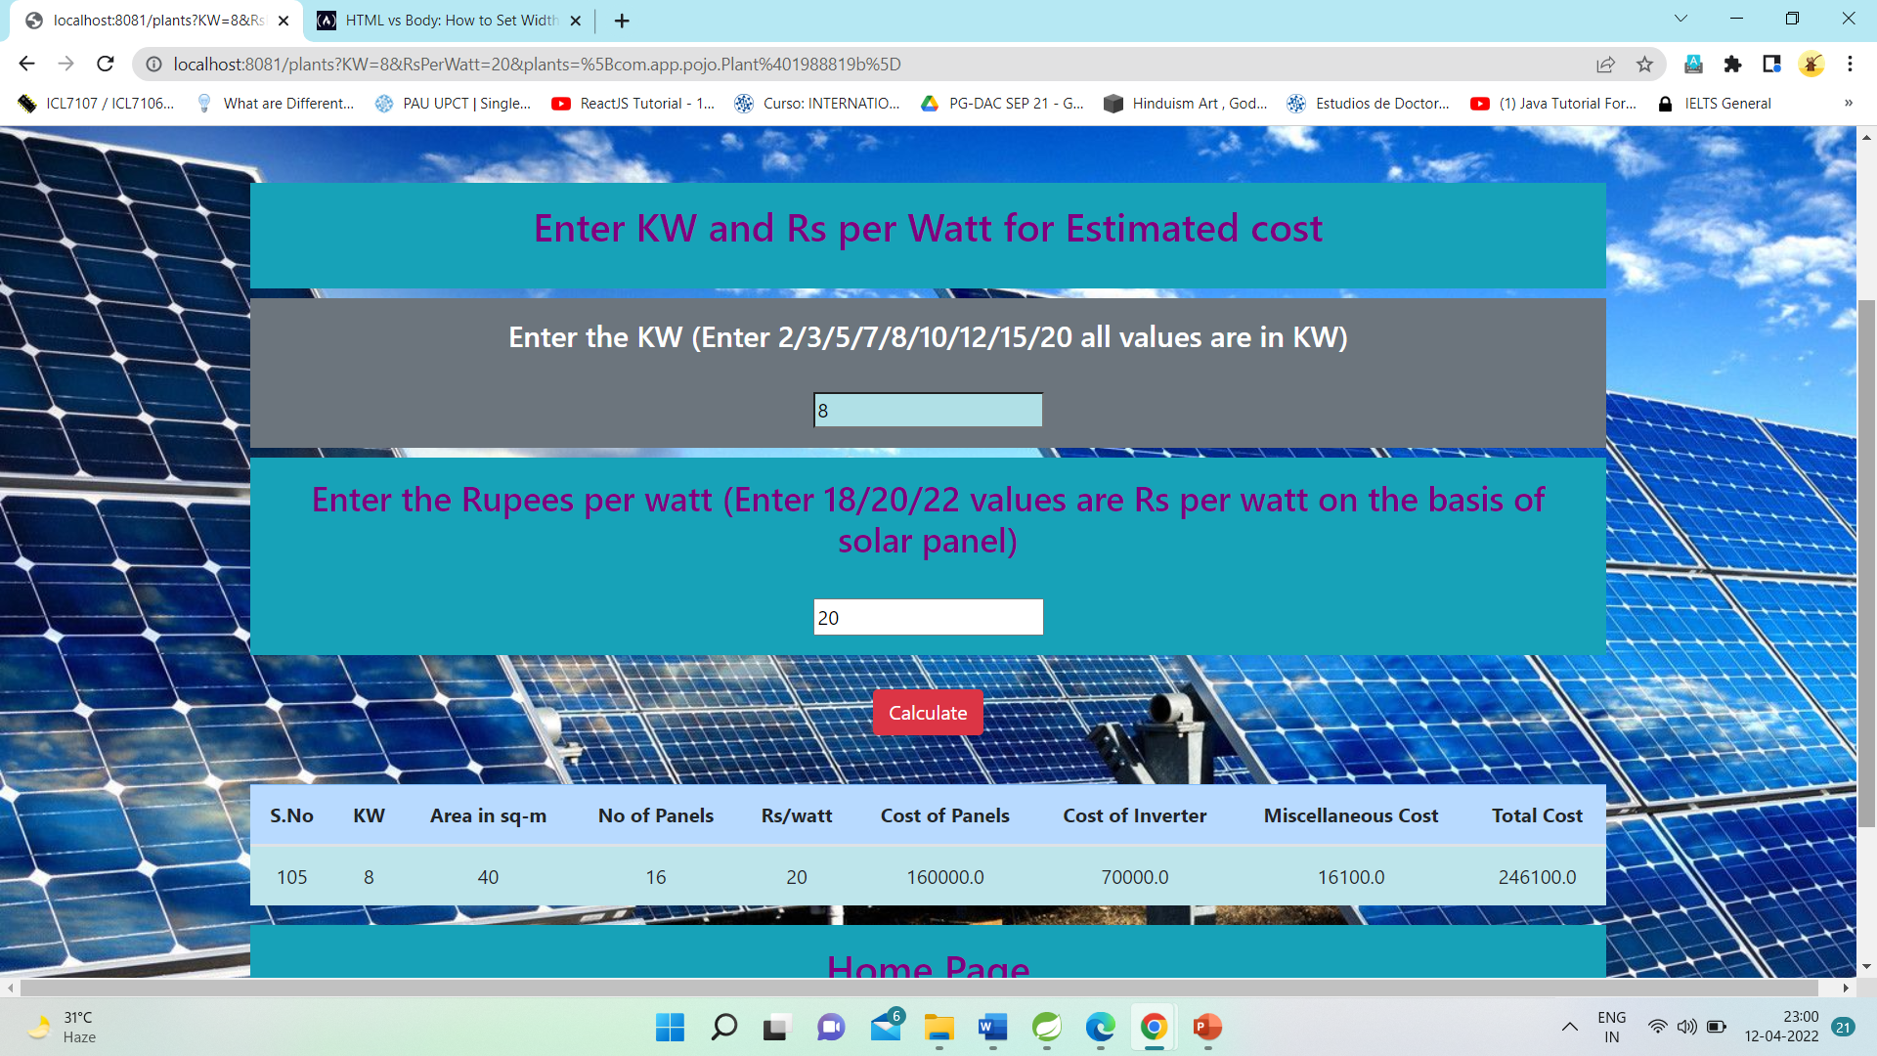
Cost Estimation page

Slide 14
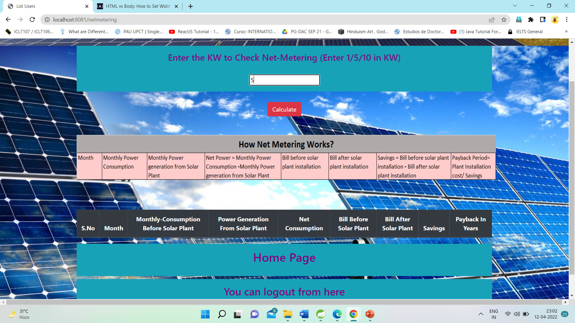
Net Metering Page

Slide 15
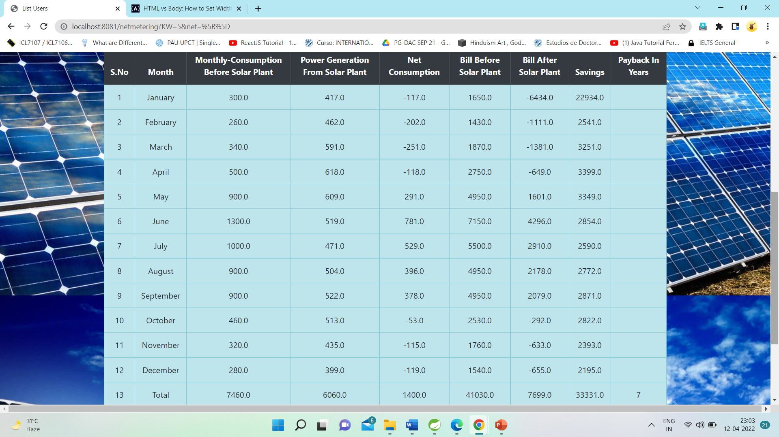
Net Metering Page Table

Slide 16
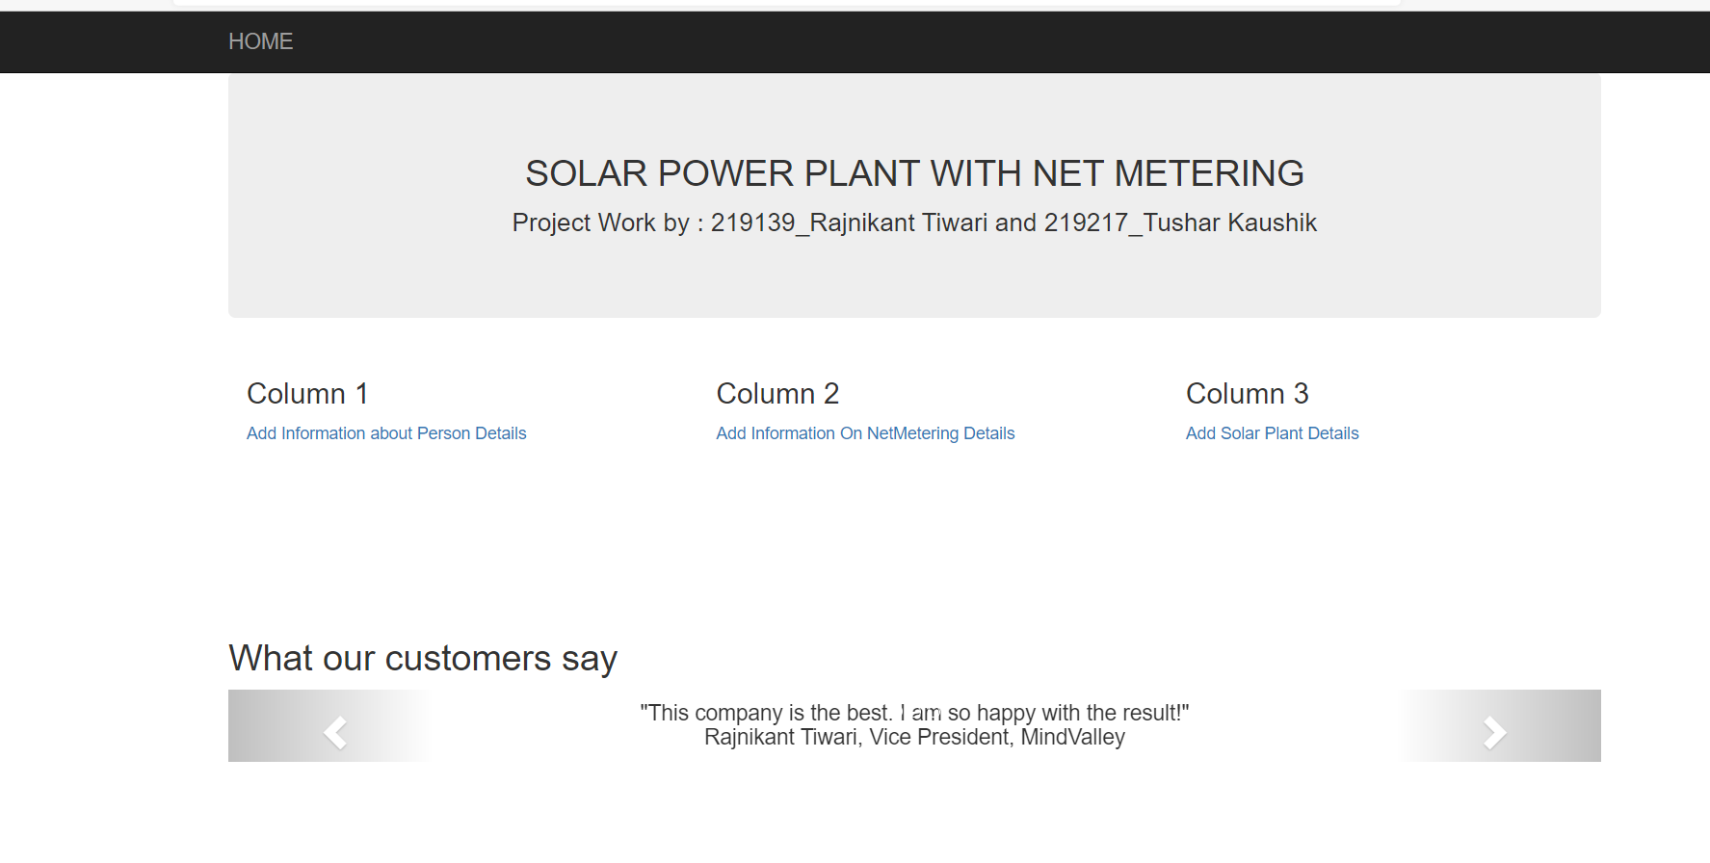
Project in ASP.NET

Slide 17
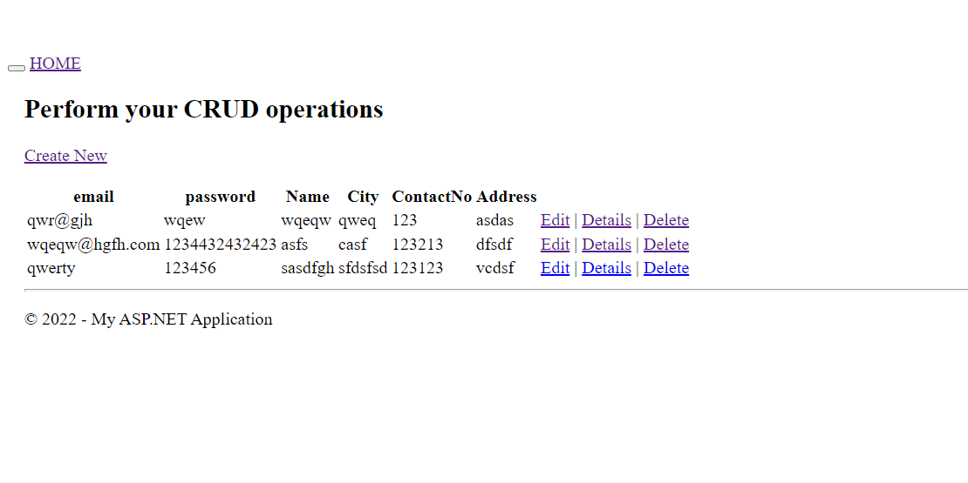
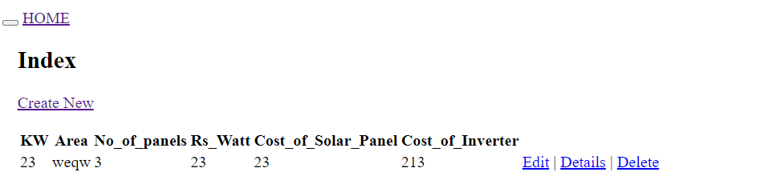

Slide 18
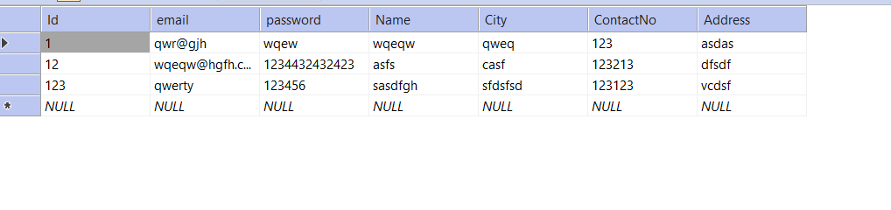
DATABASE TABLES

Slide 19
S/W and H/W Requirements
Server Side:
Processor: Intel® Xeon® processor 3500 series
HDD: Minimum 500GB Disk Space
RAM: Minimum 4GB
OS: Windows 10
Database: MySQL
Client Side (minimum requirement):
Processor: Intel Dual Core
HDD: Minimum 80GB Disk Space
RAM: Minimum 2GB
OS: Windows 7

Slide 20
Advantages
Hassle free cost estimation of solar plant along with net metering.
No physical presence is required.
No fee is required to use the system.
User friendly interface.
Additional and necessary information is given.

Slide 21
Disadvantage
Registrations is must before using the features.
Does not provide information on carbon reduction. But that can be done as future enhancement.

Slide 22
THANK YOU!

